Slide 1
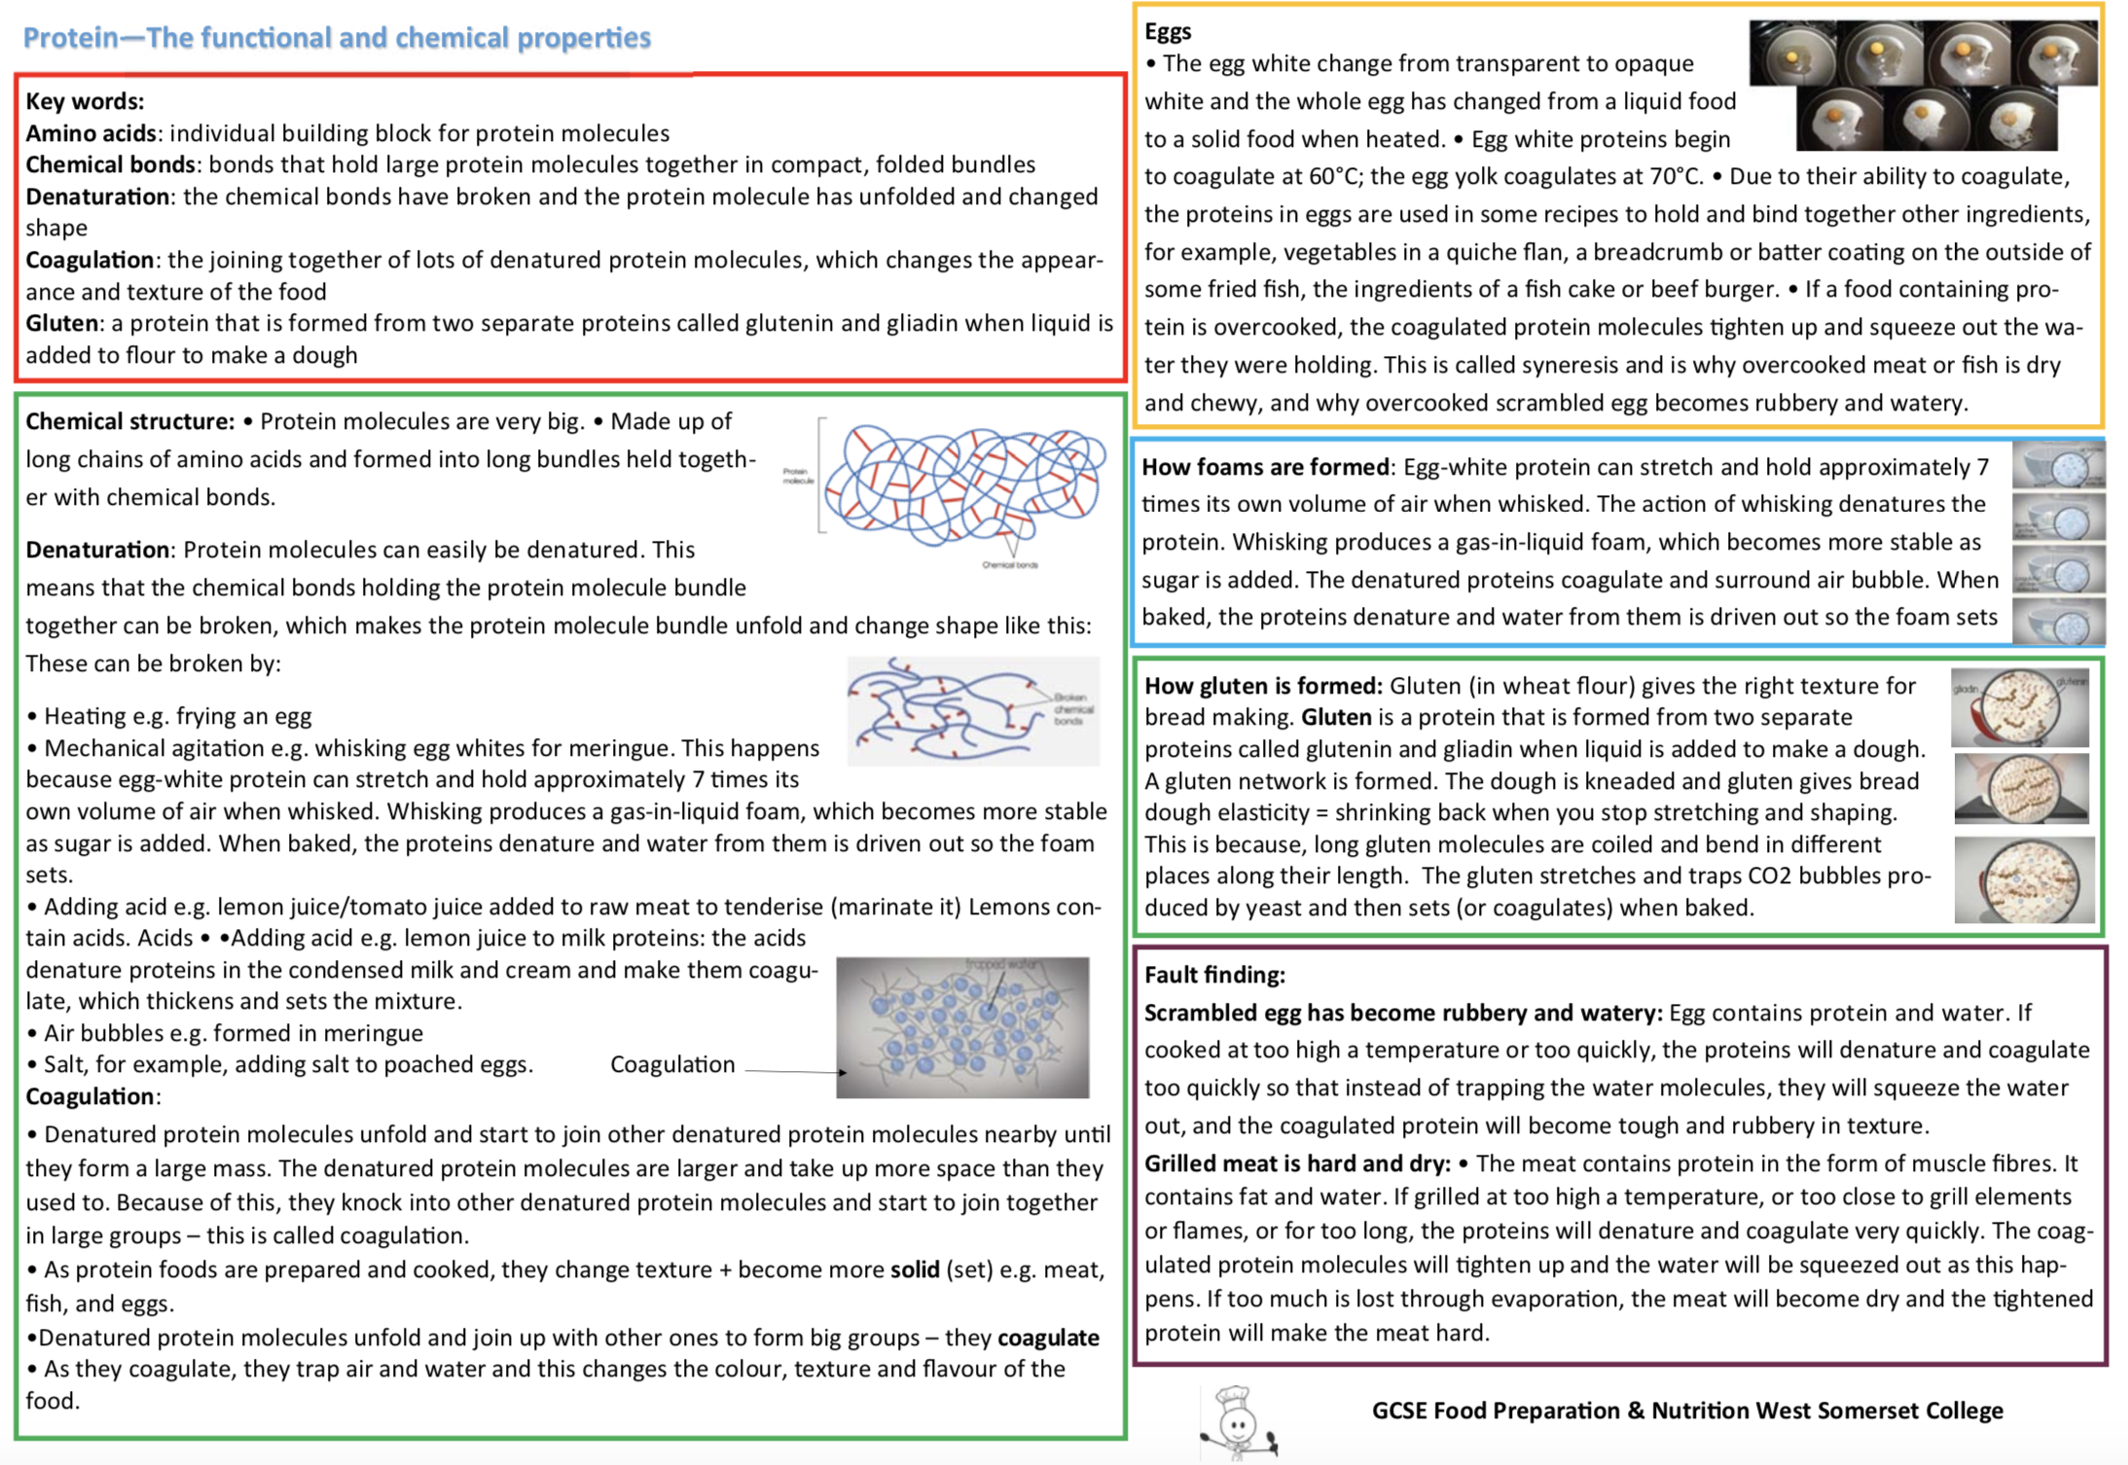
YEAR 11 TERM 2

