Slide 1
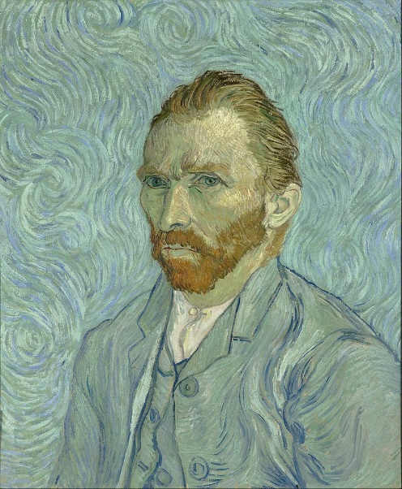
The loose, swirling pattern in the background of the painting gives the impression of smoke, or of movement. Van Gogh’s thick use of paint adds texture to the image.
Van Gogh’s use of complementary colour make the orange of his hair and beard stand out against the blues in the painting.
The use of light and dark tones on the face help to show its form
Van Gogh uses thick lines to describe his shapes – this is not realistic, but adds boldness to the painting.

Slide 2
Tone Tone describes the lightness and darkness of an image. When drawing with tone, you should aim for at least 5 different tonal values: White, Light Grey, Mid Grey, Dark Grey and Black. Pencil Grades: The different grades of pencil each have a different tonal value. Hard pencils (H) contain more clay, and are lighter. Black pencils (B) contain more graphite, and are darker. An HB (HARD/BLACK) pencil is in the middle of this range and will give you a mid grey (HB pencils are good for lightly sketching out your line work)
SECONDARY
PRIMARY
PRIMARY
SECONDARY
SECONDARY
PRIMARY

Slide 3
Key Words
Portrait | A likeness or image of a person. Portraits can be drawings, paintings, photographs or even sculptures. Often they focus mainly on the subject’s face.
Self Portrait | A portrait of the artist making the image.
Proportion | In art, the relationship between one thing and another in terms of size and distance
Profile | In portraiture, when the subject is viewed from the side.
Subject | The main focus of a work of art. The person, object or scene that is the focal point of the image.
Identity | Who a person is – what characteristics or features they might have that make them unique.
Iris | The coloured part of the eye.
Pupil | The dark hole in the centre of the iris.
Philtrum | The indentation in the middle of the upper lip, beneath the nose.
Renaissance | Literally means “rebirth”. A time from the 14th – 17th century when classical art and philosophy were rediscovered, creating a new age of science and culture.
Symbolism | Using an object or word to represent or show something else (e.g. a book to represent knowledge)
Primary Colour | Colours which can’t be made by mixing other colours – Red, Yellow and Blue
Secondary Colour | Colours made by mixing two primary colours – Green, Purple and Orange
Complimentary Colour | Colours which are opposite on the colour wheel – Red/Green, Blue/Orange, Yellow/Purple
Harmonious Colour | Colours that sit next to, or near each other on the colour wheel – e.g. Blue, Green, Yellow
Gradient | A gradual change in tone or colour, without stops between
Composition | The combination of parts (or elements) to form a whole. The structure of art, music or even writing.
Medium/Media | The materials a work of art is made from – e.g. pencil, paint, chalk, ink, photography
Mixing | With paints, inks or other wet media, combining two or more colours to create a third.
Blending | Similar to mixing, but can be done with dry media. The colours are combined on the paper or canvas.
Abstract | Art that does not attempt to represent reality – colours, tones, lines and shapes.
Figurative | Art that does try to represent reality, showing figures or objects that exist in real life.

Slide 4
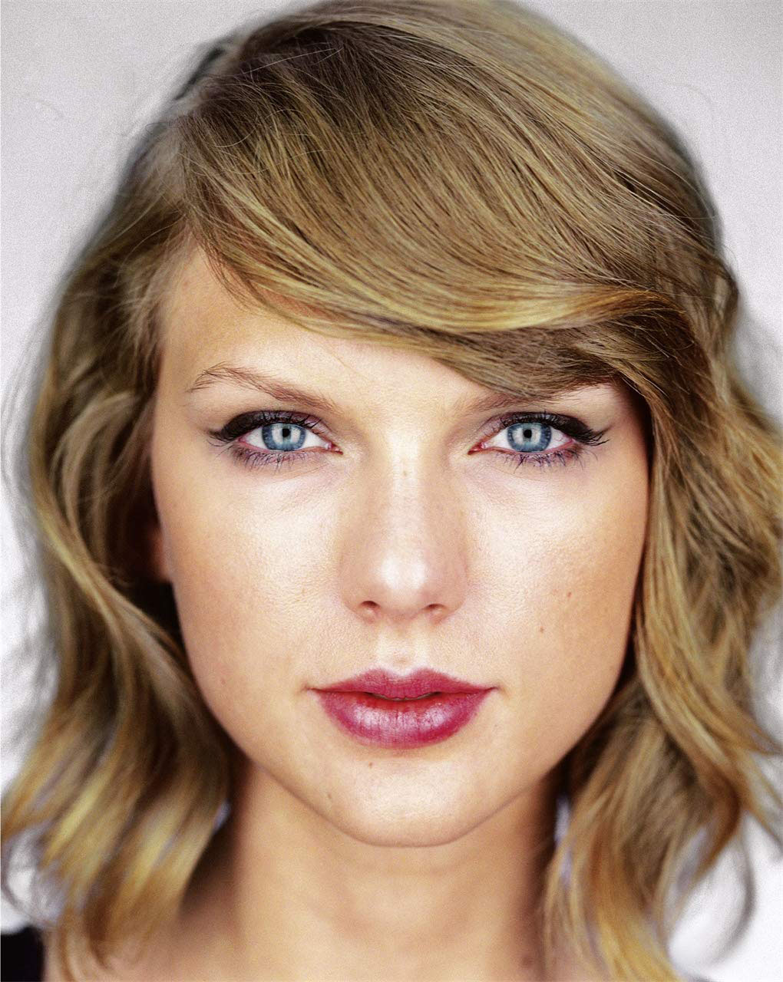
Proportions of the Face
The space between the eyes is about the same as the size of one eye.
The eyes are HALF WAY between the top of the head and the chin
About 4 – 5 eyes could fit across the head
The edges of the nose line up with the inside of the eyes
The base of the nose is HALF WAY between the eyes and the chin
The base of the bottom lip is half way between the nose and the chin
The edges of the mouth line up close to the middle of the eye

Slide 5
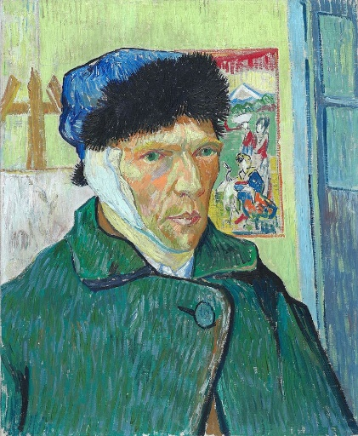
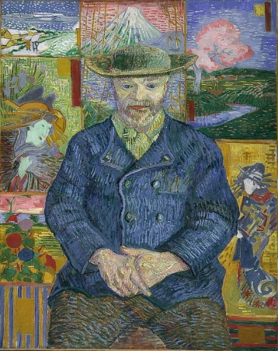
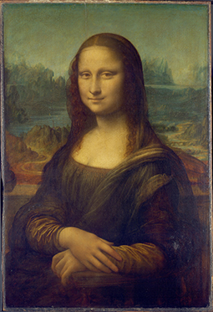
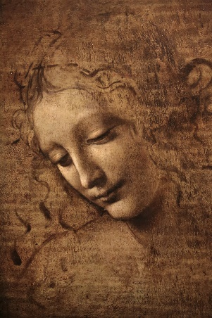
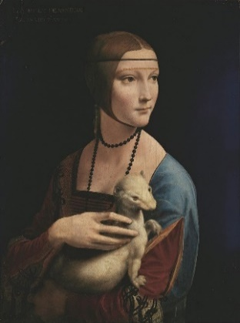
Portrait Artists
Leonardo da Vinci (1452 - 1519)
Leonardo da Vinci (which means “Leonardo from Vinci” – da Vinci is not a family name) was an Italian painter, scientist, engineer, sculptor and architect of the Renaissance.
His most famous portrait – the Mona Lisa – is most probably the most recognised painting in the world.
Leonardo pioneered many artistic techniques which are still used today. Although not many of his paintings have survived, his understanding of light, proportion, the human form and expression along with many others make him probably the most influential artist of all time.
Self Portrait with Bandaged Ear (1889)
Portrait of Pere Tanguy (1887)
Vincent Van Gogh (1853 - 1890)
Vincent Van Gogh was a Dutch painter who, in his short life, created over 2000 artworks, and after his death became one of the most influential painters in history.
Mona Lisa (1503 - 1506)
Self Portrait (1889)
Van Gogh’s paintings can be recognised by his use of bold colour, often combining complementary colours, and by his thick, textured brush strokes.
He was not recognised as a great painter in his lifetime, only ever selling one painting during his life. It was not until after he took his own life in 1890 that his unique style began to be appreciated.
La Scapigliata (Lady with Dishevelled Hair) (1506 - 1508)
Lady with an Ermine (1489 - 1491)

Slide 6
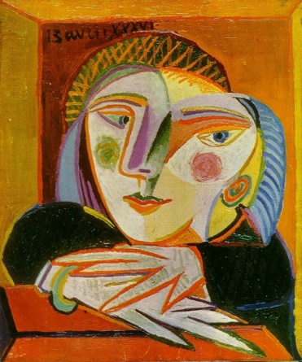
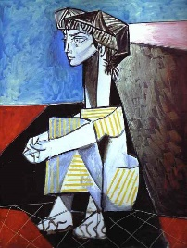
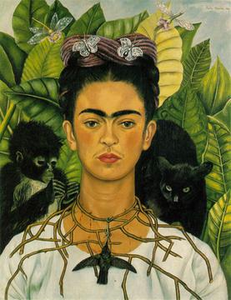
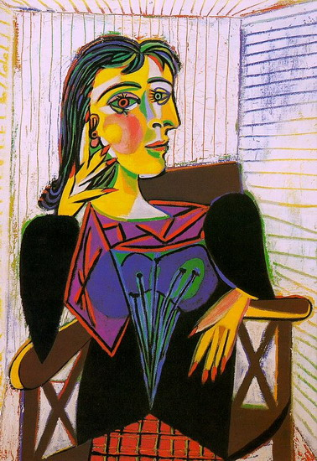
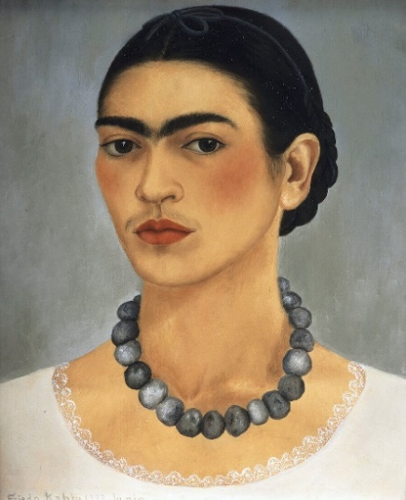
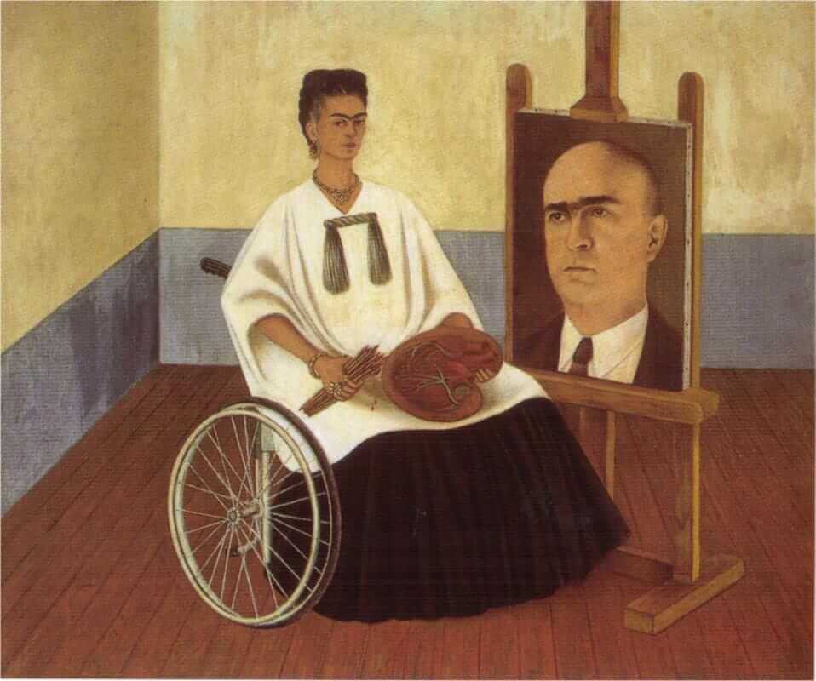
Portrait Artists
Frida Kahlo (1907 - 1954) Frida Kahlo was a Mexican painter known for her portraits and self-portraits. She was inspired by the nature and culture of Mexico, and used elements of its identity within her work. Her paintings often mixed reality with fantasy, and often contained symbolism.
Kahlo started painting after a bus accident left her bed ridden and in considerable pain – she often used her paintings as a way to express her feelings about this, or about other issues such as race, gender or class.
Woman at Window (1936)
Jacqueline with Crossed Hands (1954)
Pablo Picasso (1881 - 1973)
Spanish artist Pablo Picasso is probably the most famous artist of the 20th Century. He was able to paint highly realistically from a very early age, but began to experiment with new ways of showing the world. Picasso helped invent Cubism – an abstract style which showed objects from lots of different angles at the same time.
Self Portrait with Thorn Necklace and Hummingbird (1940)
Portrait of Dora Maar (1937)
Picasso was a painter, sculptor, printmaker, theatre set designer and so much more. He created thousands of artworks throughout his lifetime – all very recognisable as his by their distortion of form, line and colour.
Self Portrait with Necklace (1933)
Self Portrait with the Portrait of Dr Farill (1951)

Slide 7
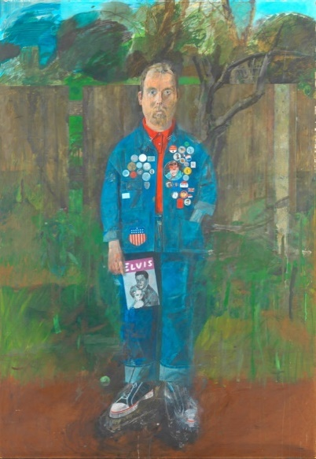
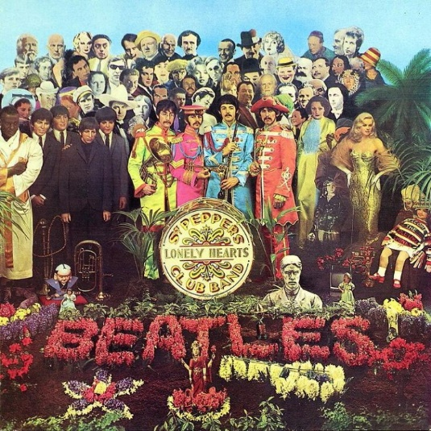
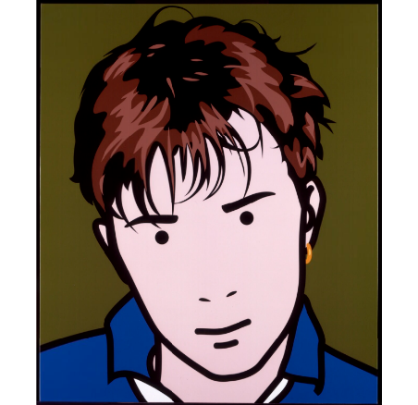
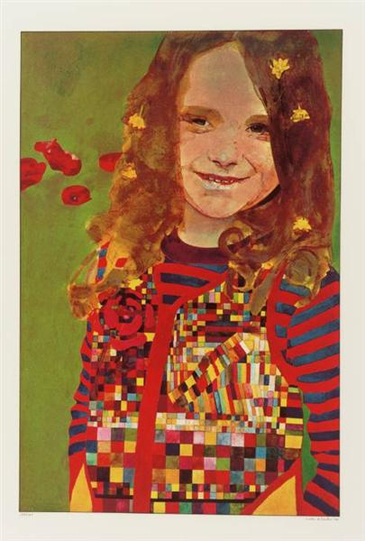
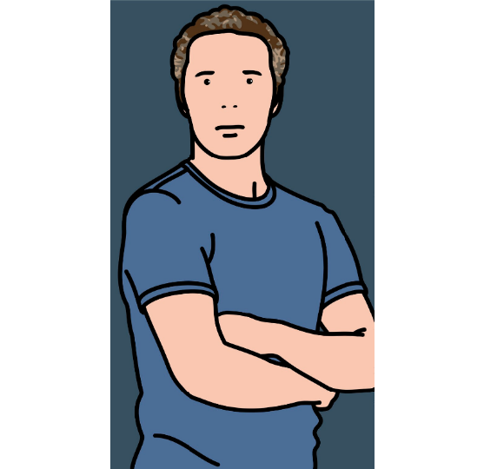
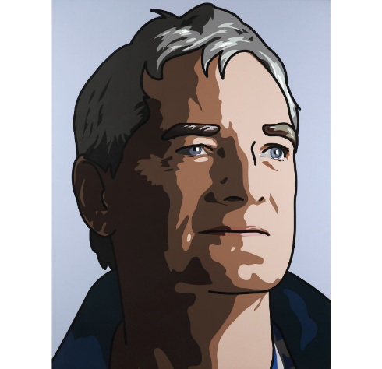
Portrait Artists
Julian Opie (born 1958)
British artist Julian Opie uses a range of media, including painting, sculpture and digital art to create his stylistic portraits. His work is recognisable by its simplified style, which is almost comic book like, or cartoonish.
Opie’s most famous portraits reduce the features of his subjects down to a few simplified lines to show what makes us recognisable. Some of his more recent work shows a little more detail, but is still very simplified.
Album cover for The Beatles’ “Sgt Peppers Lonely Hearts Club Band”(1967)
Self Portrait with Badges (1961)
Peter Blake (born 1932)
Sir Peter Blake is a British artist famous for his use of popular culture in his artworks. “Pop Art” is an art movement which was popular in Britain and America in the late 1950s and 1960s.
Blake uses a range of different styles and techniques, such as painting, printing and collage.
Damon Albarn (2000)
Julian with T Shirt (2005)
Girl in a Poppy Rield (1974)
His cover for the Beatles’ album “Sgt Pepper…” was a photograph of the band in a detailed set, which included life size cut outs of famous people and wax works of the band from Madame Tussaud’s.
James, Inventor (2010)

