Slide 1













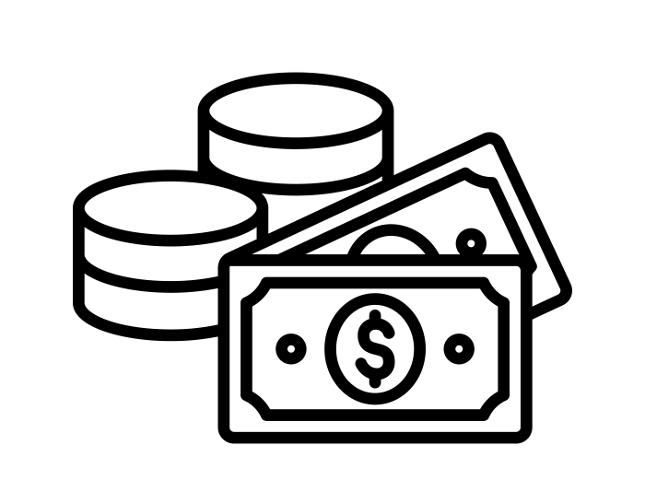

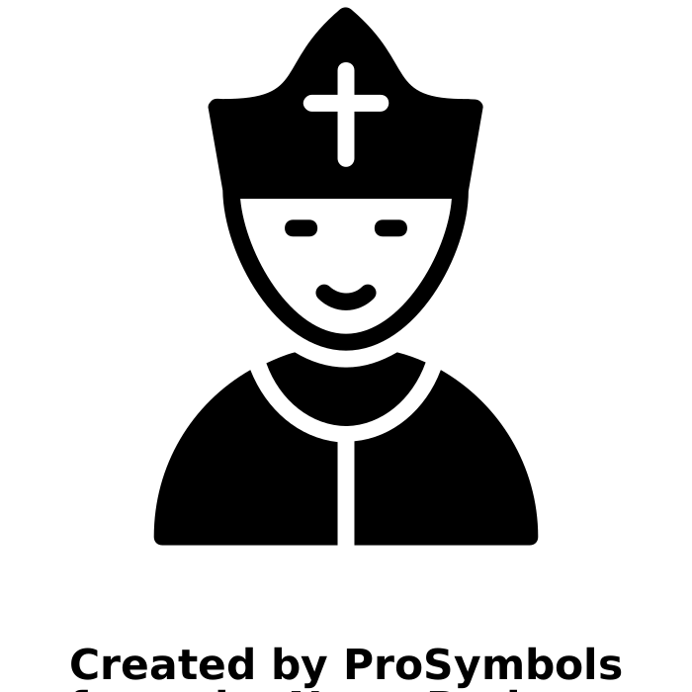








Why did Henry VIII break with the Catholic Church?
1509
Henry becomes King
1510
Marries Katherine of Aragon
1527
Meets Anne Boleyn
Jan 1533
Married Anne Boleyn
1534
Changes the Church
1536
Shuts all monastic houses
1537
Edward is born
1547
Henry dies
 | Key word | Definition
 | Annulment | Like a divorce- says that people are no longer married.
 | Advisor | Someone who helps, gives advice.
 | Catholic | Religion with the Pope as head of the church
 | Communion | Part of the service that involves the bread & wine
 | Dissolution | To end something
 | Heresy | To speak against the official faith
 | Heir | The next person in line to the throne
 | Latin | Ancient Roman language used by Catholics
 | Monarch | A King or Queen
 | Monastery | A religious building where monks live
 | Pope | Head of the Roman Catholic church
 | Protestant | Belief that the King should be head of the church
 | Reformation | Changing of the church from Catholic to Protestant
 | Reformer | Someone who wants to change the church.
Why Anne Boleyn? Truth to tell, I was more fascinated by her than by any other historical figure, I can’t explain this, any more than I can explain the feeling of recognition I had had at age seven when I first heard of her. Of course, there is much in Anne Boleyn’s story to fascinate anyone, so I would not wish to be too fanciful about this. Later, when I came to research her life in depth and from a more mature viewpoint, I realised that I did not particularly like Anne Boleyn as a character. Yet the fascination remains. She is a romantic heroine in the truest sense.
Alison Weir
 | Knowledge milestones | Extra knowledge | Expert knowledge
 | The Protestant strand of Christianity developed in 1500s as people “protested” against the Catholic church. | Martin Luther was a German monk who started the Reformation by criticising the Catholic church. | Luther said that the church was too rich, he did not want to start a new church, just make the existing one better.
 | Henry VIII made himself head of the Church of England in 1534 | The law that made Henry head of the church was called “The Act of Supremacy”. | Henry also had a bible published in English with a picture of himself on the front.
 | Henry changed the church because he wanted to divorce his wife Catherine of Aragon and marry Anne Boleyn. | The Pope would not allow Henry to have a divorce, but by changing the church he could grant the divorce himself. | The Pope was being controlled by Catherine of Aragon’s nephew, Charles V, who was unhappy at how Henry was treating his aunt.
 | Henry needed a male heir and Catherine was too old for any more babies. He needed a new wife. | Catherine had only had one living child- Mary- Henry wanted a son to be king after him. | Henry saw Catherine’s lack of living sons as a sign he should marry someone else.
 | By changing the church he could shut down the monasteries and take their money. | The monasteries owned ¼ of all the land in England, by shutting them down Henry took this money. | Henry wanted the money so that he could go to war with France and try to gain land and glory for himself.
 | The Pope had a huge amount of power. By becoming head of the church Henry could gain more power. | Many people saw being loyal to the pope as more important than being loyal to the king. | Henry wanted power to rival the kings of Spain (Charles V) and France (Francis I).
 | Some people in England were Protestant. This included some of Henry’s advisors. | Cromwell was Henry’s main advisor and was a reformer. | Cromwell and Arch Bishop Cranmer worked to make protestant changes to the church.
If you want to find out more check out the following links or scan the QR codes on your phone or tablet.
READ
WATCH
LISTEN
https://www.historyextra.com/period/tudor/starkey-on-the-reformation-2/
http://www.versushistory.com/podcasts.html
Episode #51
https://m.youtube.com/watch?v=QlHWZw36FAM

Slide 2










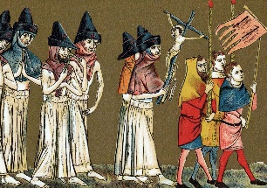
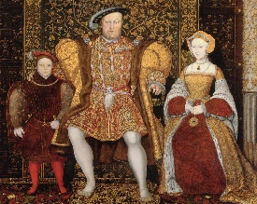
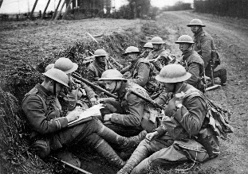


Writing good History: Key skills
Chronology
The order in which events happen. The big “story”.
Change/ Continuity
Whether things have changed or remained the same over time.
Similarity/Difference
What events or situations have in common, and how they are different.
Cause
The reasons that something happens- long term or trigger cause.
Consequence
Things that happen as a result of an event. Can be good or bad.
Significance
Whether an event is important or not. The impact it has had on people. How it has changed the world.
Sources
Information that comes from the time studied, or that was produced by someone who was there at the time.
Interpretations
The views of people who were not there at the time but have researched the event.
EXTENDED WRITING: What do I need to know?
USING SOURCES: What do I need to know?
 | Make sure you include more than once cause when asked to explain WHY something happened.
 | If asked if you AGREE you need to include arguments for why you do agree (SUPPORT the statement) and arguments for why you disagree (CHALLENGE the statement). This called having a BALANCED ARGUMENT.
 | Try to use the PEE structure- make a POINT that answers the question, add DETAILED EVIDENCE (examples) to support your point, and then EXPLAIN how these are linked.
 | Include ANALYSIS that measures the importance of each reason- are they long/short term? Which impacts more people? Are the reasons/points connected?
 | Say which reason is most important, or whether you agree or disagree with the statement. This can be done as a conclusion.
 | Inferences- to make an inference you need to state what you can learn, or work out from a source. Make sure you take note of the focus of the question!
 | Utility- when looking at how USEFUL a source is, you first must state what information the source gives you about the topic in the question. This is the CONTENT of he source. Does the source SUPPORT or CHALLENGE your own knowledge?
 | Utility- You next need to look at the PROVENANCE of the source. This means looking at who wrote the source, when it was written, what type of source it is and why it might have been produced. Do these things make the source RELIABLE?
 | If answering a “how useful” question you need to make a judgement- How useful is it? Extremely? Quite? Not very? Not at all? You can do this in a CONCLUSION
 | Whenever you use written sources you must QUOTE from the source, if using a picture source you must mention something you can SEE in the picture.
Suggested Vocabulary: What do I need to know?
To show importance | To agree/disagree | Linking points
The primary reason… | The evidence supports the view that… | This meant that…
The most significant cause… | This view is convincing because… | The impact of this was…
A crucial role was played by… | One reason to agree is… | In addition to this…
Of lesser importance was… | An alternative view is… | This acted as a catalyst for…
A key factor was… | A less supported view is… | This led to…
The fundamental cause… | A less convincing argument is… | An immediate consequence was…
A less significant reason… | It is clear that… | Long term this was significant because…
USING INTERPRETATIONS: What do I need to know?
 | When looking at the similarities or differences between interpretations make sure you mention the point of view given in BOTH interpretations.
 | If you are asked to suggest reasons WHY the interpretations have different views think about whether they FOCUS on different things, or whether one is POSITIVE and the other NEGATIVE, might the authors have done different RESEARCH?
 | To decide how far you AGREE with an interpretation, use your own knowledge- does this SUPPORT or CHALLENGE the view given in the interpretation?
 | You can also use sources to help you decide whether an interpretation is VALID- do the sources support or challenge the view in the interpretation? Are the sources RELIABLE?
 | Remember to always include QUOTES from the interpretations, and include a JUDGEMENT in the conclusion- do you agree?

