Slide 1
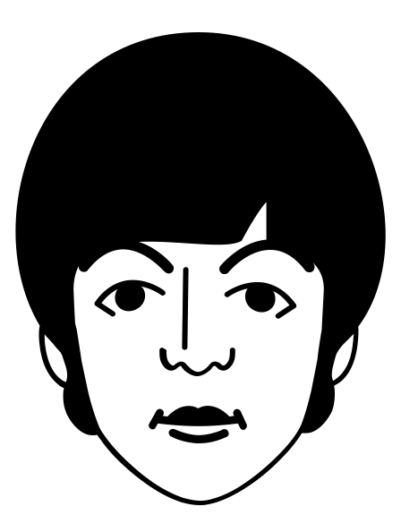
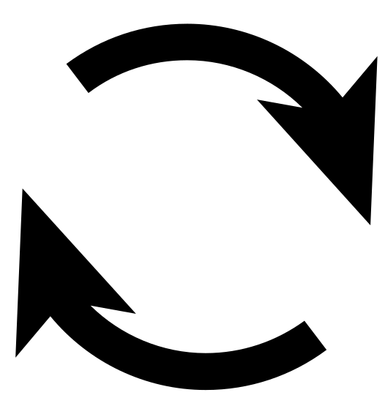
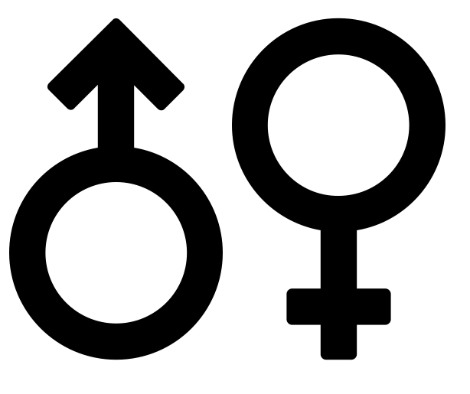
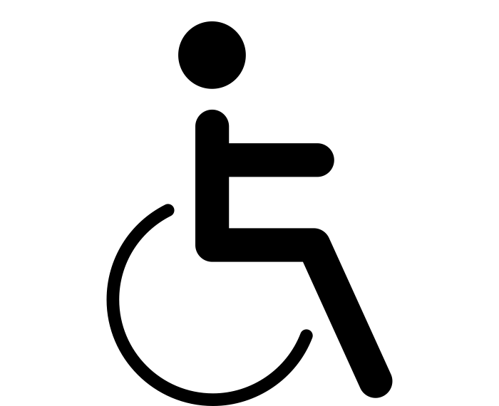
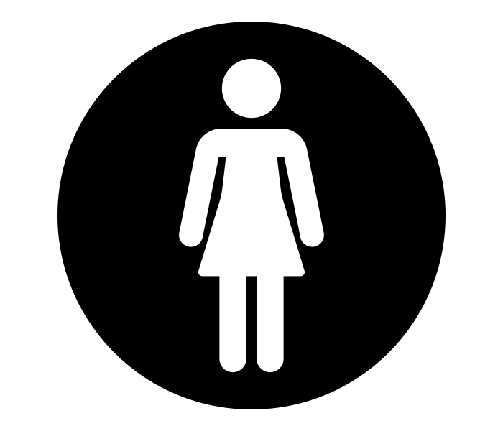
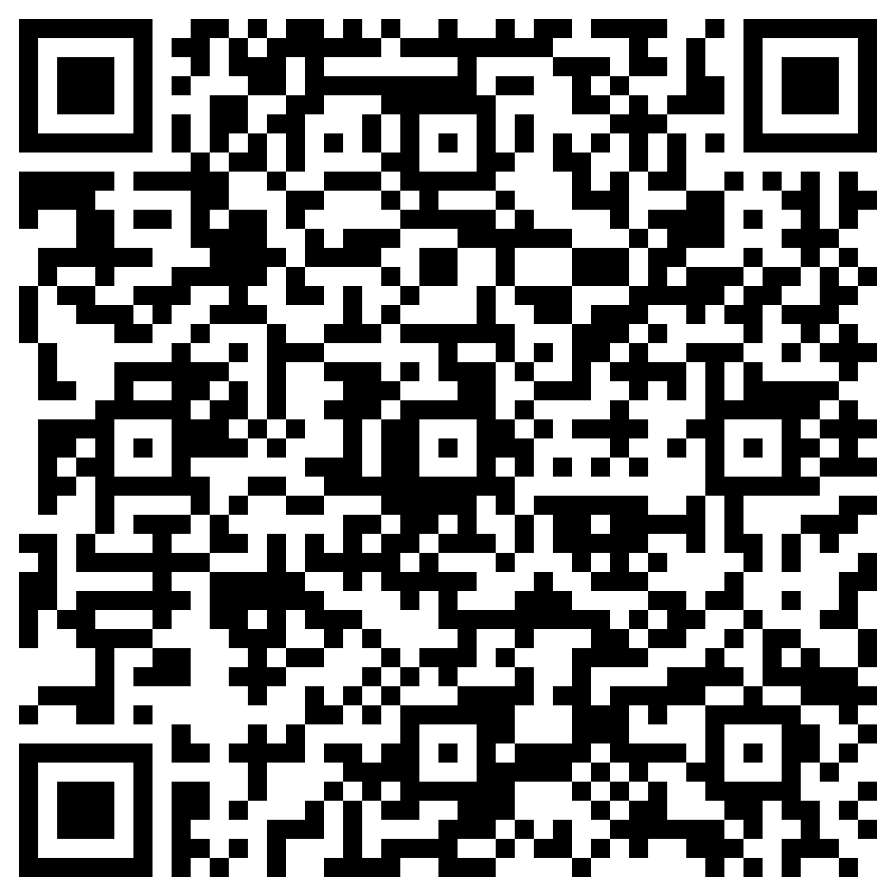
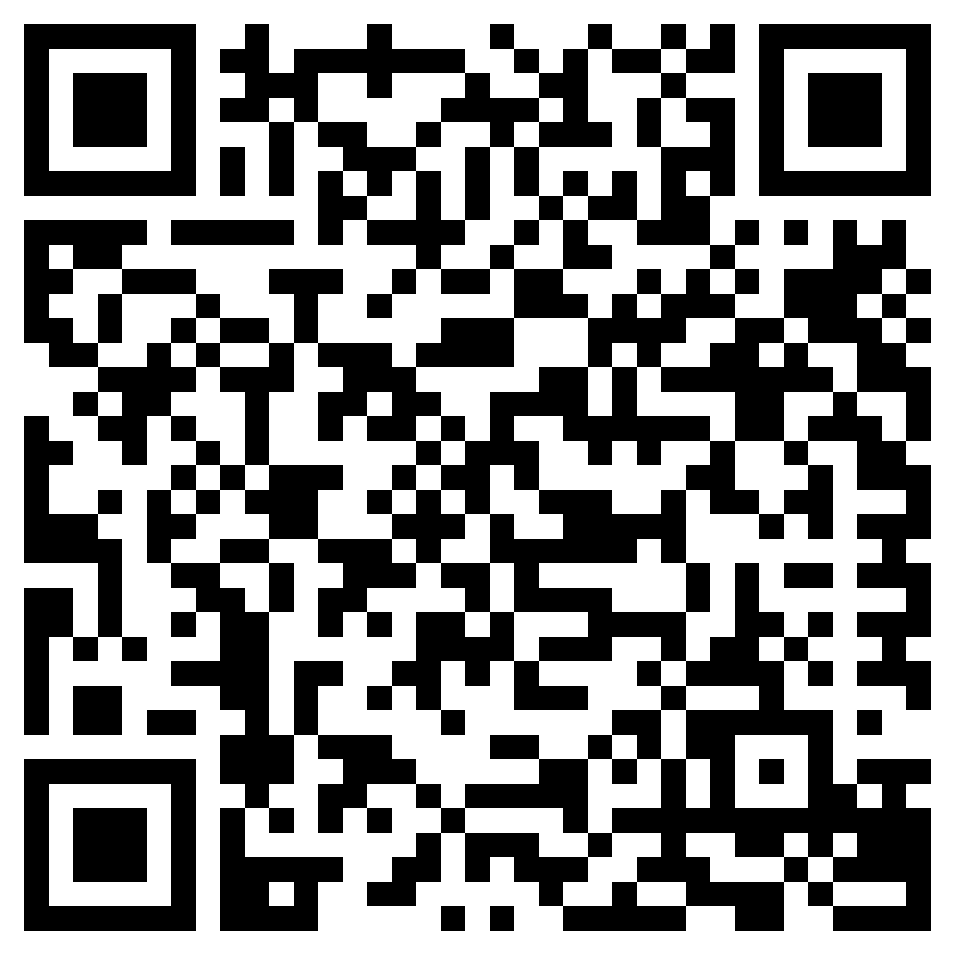
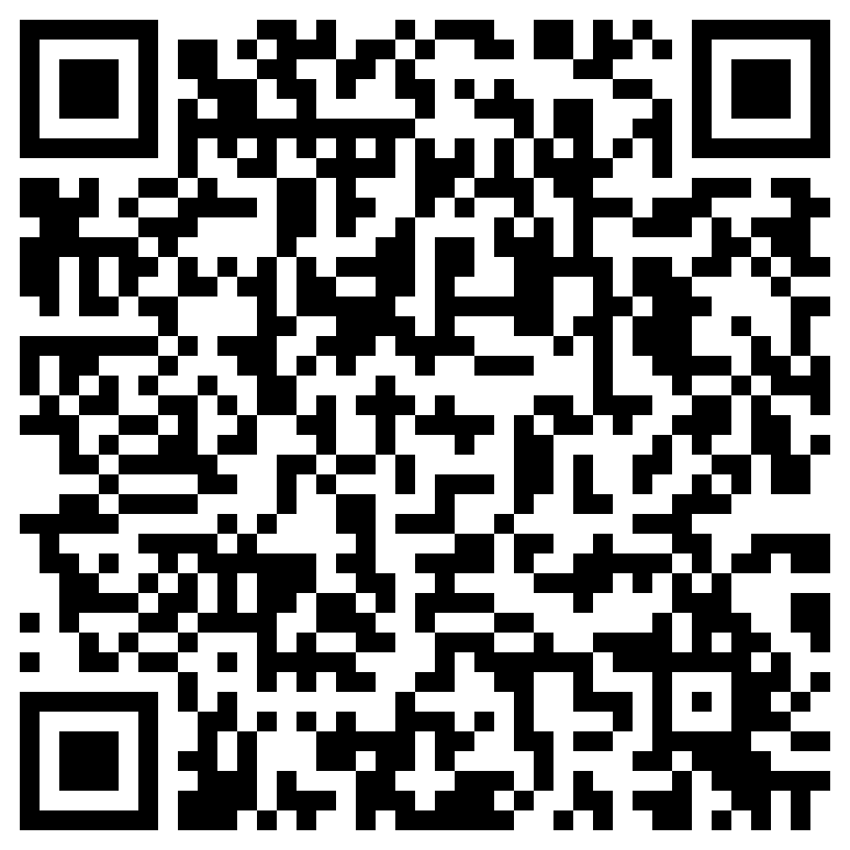
Were the Sixties “swinging” for everyone in Britain?
1942
Beveridge
Report
1948
NHS
introduced
1961
Contraceptive Pill
1965
Paul Hunt
Protest
1966
World Cup Victory
1967
Sexual
Offences
Act
1968
Dagenham
Ford Strike
1970
Equal Pay Act
 | Key Word | Definition
 | Abortion Act | Allowed legal abortion after 1967.
 | Beatlemania | Fanaticism of Beatles fans in the 1960s.
 | Change | Something that is different from what it once was.
 | Continuity | Something staying the same.
 | Contraceptive Pill | Introduced in 1961. A pill to prevent pregnancy.
 | Gay Liberation Front | Set up in late 1960s to campaign for gay rights.
 | Gender | Social, cultural, behavioural aspects of being a man/ women.
 | Protest | A statement or action expressing disapproval.
 | Sexual Offences Act | 1967 Act of Parliament that legalised homosexual activity.
 | Strike | Refusal to work as a protest against conditions.
 | Welfare State | The government takes measures to protect the health and well-being of its citizens.
 | Women’s Liberation | Founded in the late 1960s to campaign for equal rights.
 | UPIAS | Pressure group formed by Paul Hunt on disability rights.
This book presents a rather different version of British history in the sixties. I have very little interest either in celebrating a golden age of hedonism and liberation, or in condemning an equally exaggerated era of moral degradation and national decline. What this book argues is that the British experience in the 1960s was much more complicated, diverse and contradictory than it has been given credit for.
Dominic Sandbrook, 2015
 | Knowledge Milestones | Extra Knowledge | Expert Knowledge
 | In 1942 the Beveridge Report was published. It identified five giants. | When the Labour Party came to power in 1945, they brought in the Welfare State. | Part of the Welfare State was the NHS. This provided free medical care.
 | There were significant cultural changes. For example, the Mini was very popular. | There were also changes for young people including the mini-skirt and Beatlemania | However, these changes did not affect everyone in society.
 | In 1961, the contraceptive pill was introduced. | The Abortion Act was passed in 1967. This made abortion legal. | Until 1969, the contraceptive pill was only available for married women.
 | In 1968, women at Dagenham went on strike to complain about working conditions. | This led to the Equal Pay Act 1970. Even so, not all women received equal pay. | In 1976 British Asian women went on strike at the Grunwick Laboratory.
 | After WWI, there was a more sympathetic reaction to disability e.g. the March for Blindness. | In 1965, Paul Hunt organised a protest at Le Court to increase the independence of residents. | In 1972, Hunt went on found UIPAS which campaigned for disability rights.
 | In 1967, the Sexual Offences Act decriminalised sex between men over 21. | In 1970 the Gay Liberation Front is formed. This leads to the first Pride March in 1972. | In 1968, Ewan Forbes was able to defend his corrected birth certificate.
 | In the 1960s the UK operated a colour bar. This meant that black and Asian people struggled to get jobs. | In 1961, the WIDC was created to challenge this ruling. Paul Stephenson was their spokesperson. | In 1963, they organised a boycott in Bristol. This was successful and led to the Race Relations Act 1965.
READ
WATCH
LISTEN
If you want to find out more check out the following links or scan the QR codes on your phone or tablet.
White Heat: A history of Britain in the Swinging Sixties by Dominic Sandbrook | The Independent | The Independent
History KS3: What was life like for young people in 1960s Britain? - BBC Teach
History Extra podcast: Britain’s Swinging Sixties: everything you wanted to know on Apple Podcasts

