Slide 1
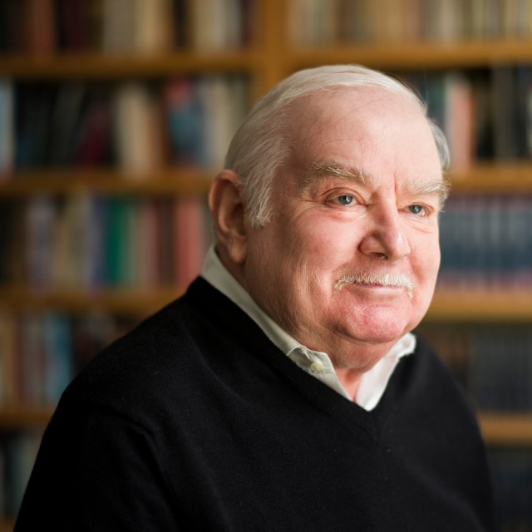
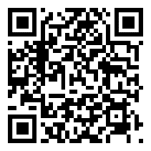
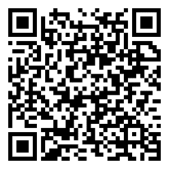
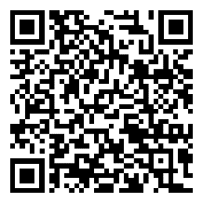
Did the power of Medieval Monarchs change between 1066-1215
1152
Eleanor marries Henry II
1165
Becket & Henry II fall out
1173
Eleanor supports sons rebellion
1181
Becket is murdered
1189
Third Crusade begins
1203 John murders his nephew
1206
John fell out with the Pope
1215
John is forced to sign Magna Carta
 | Key Word | Definition
 | Archbishop | In charge of the Church in England.
 | Baron | Wealthiest men in England.
 | Crusade | Wars to reclaim Jerusalem.
 | Democracy | Everyone is able to vote for their government.
 | Excommunicated | Banned from Church. This means that people could not get to heaven
 | Government | Runs the country. During the Middle Ages it was the monarch.
 | Jihad | A holy or just war within the Islamic faith/world.
 | Magna Carta | Document agreed by John. Restricted the power of the monarchs.
 | Parliament | A law-making assembly
 | Pope | In charge of the Catholic Church. Lives in the Vatican City in Rome
 | Rebellion | Rise up against the monarch.
 | Saladin | Islamic ruler during the 3rd Crusade against Richard I
 | Siege | Surround a castle of town. Force it to surrender.
But this was not a new code of law. It was not even a summary of the great principles of legislation. It was essentially an attempt by the barons to return to the state of affairs before the dominance of the Angevin kings. It did not represent a spirit of “progress” or development in human affairs. None of the participants would have known what those words meant. It was in part a reactionary document. Villeins and slaves, the most numerous portion of the kingdom, were never mentioned. The unfree were of no consequence. Their “progress” over the century was slow and uncertain.
Peter Ackroyd, Foundation
 | Knowledge Milestones | Extra Knowledge | Expert Knowledge
 | Henry II acted as lawgiver, judge, defender of the Empire & Protector of Church | He faced problems with the Barons (not respecting him) & Priests (Loyal to the Pope) | Solved this by destroying the Baron's Castles & stone castles of his own.
 | There was a clash between Becket & Henry II | They disagreed over who had the power to appoint Archbishops. | The Pope banned John from Church. This is excommunication.
 | Eleanor was Queen Consort to Henry II | In 1147 she organised funds for the 2nd Crusade showing power of rule. | She openly supported her three sons rebellion against Henry II
 | The aim of the crusades was the Church reclaiming the Holy Lands from the Muslims | Richard I was quite brutal in the way he fought against Saladin – Yet also entered discussions. | Despite being a warrior, Saladin had respect for his opponents and treated with honour.
 | John was forced to agree to Magna Carta. | The Magna Carta was agreed on June 15th 1215. | The Magna Carta contained 63 clauses or promised that John agreed to.
 | The Magna Carta was important because it limited the King’s power. | Taxes had to be agreed and the liberties of the Church restored. | Today three declarations of Magna Carta still remain on the statute book.
 | The Magna Carta is the basis of our democracy today. | Every English monarch has agreed to Magna Carta. | It is also reflected in the US Constitution and the UN Declaration of Human Rights.
READ
WATCH
LISTEN
If you want to find out more check out the following links or scan the QR codes on your phone or tablet.
https://www.bbc.co.uk/news/magazine-12603356
https://www.bl.uk/magna-carta/articles/magna-carta-an-introduction
https://podtail.com/en/podcast/history-extra-podcast/king-john-medieval-monster/

Slide 2
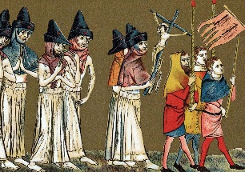
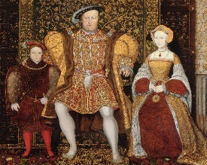
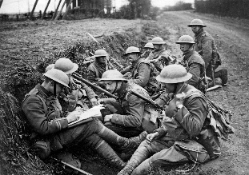
Writing good History: Key skills
Chronology
The order in which events happen. The big “story”.
Change/ Continuity
Whether things have changed or remained the same over time.
Similarity/Difference
What events or situations have in common, and how they are different.
Cause
The reasons that something happens- long term or trigger cause.
Consequence
Things that happen as a result of an event. Can be good or bad.
Significance
Whether an event is important or not. The impact it has had on people. How it has changed the world.
Sources
Information that comes from the time studied, or that was produced by someone who was there at the time.
Interpretations
The views of people who were not there at the time but have researched the event.
EXTENDED WRITING: What do I need to know?
USING SOURCES: What do I need to know?
 | Make sure you include more than once cause when asked to explain WHY something happened.
 | If asked if you AGREE you need to include arguments for why you do agree (SUPPORT the statement) and arguments for why you disagree (CHALLENGE the statement). This called having a BALANCED ARGUMENT.
 | Try to use the PEE structure- make a POINT that answers the question, add DETAILED EVIDENCE (examples) to support your point, and then EXPLAIN how these are linked.
 | Include ANALYSIS that measures the importance of each reason- are they long/short term? Which impacts more people? Are the reasons/points connected?
 | Say which reason is most important, or whether you agree or disagree with the statement. This can be done as a conclusion.
 | Inferences- to make an inference you need to state what you can learn, or work out from a source. Make sure you take note of the focus of the question!
 | Utility- when looking at how USEFUL a source is, you first must state what information the source gives you about the topic in the question. This is the CONTENT of he source. Does the source SUPPORT or CHALLENGE your own knowledge?
 | Utility- You next need to look at the PROVENANCE of the source. This means looking at who wrote the source, when it was written, what type of source it is and why it might have been produced. Do these things make the source RELIABLE?
 | If answering a “how useful” question you need to make a judgement- How useful is it? Extremely? Quite? Not very? Not at all? You can do this in a CONCLUSION
 | Whenever you use written sources you must QUOTE from the source, if using a picture source you must mention something you can SEE in the picture.
Suggested Vocabulary: What do I need to know?
To show importance | To agree/disagree | Linking points
The primary reason… | The evidence supports the view that… | This meant that…
The most significant cause… | This view is convincing because… | The impact of this was…
A crucial role was played by… | One reason to agree is… | In addition to this…
Of lesser importance was… | An alternative view is… | This acted as a catalyst for…
A key factor was… | A less supported view is… | This led to…
The fundamental cause… | A less convincing argument is… | An immediate consequence was…
A less significant reason… | It is clear that… | Long term this was significant because…
USING INTERPRETATIONS: What do I need to know?
 | When looking at the similarities or differences between interpretations make sure you mention the point of view given in BOTH interpretations.
 | If you are asked to suggest reasons WHY the interpretations have different views think about whether they FOCUS on different things, or whether one is POSITIVE and the other NEGATIVE, might the authors have done different RESEARCH?
 | To decide how far you AGREE with an interpretation, use your own knowledge- does this SUPPORT or CHALLENGE the view given in the interpretation?
 | You can also use sources to help you decide whether an interpretation is VALID- do the sources support or challenge the view in the interpretation? Are the sources RELIABLE?
 | Remember to always include QUOTES from the interpretations, and include a JUDGEMENT in the conclusion- do you agree?

