Slide 1












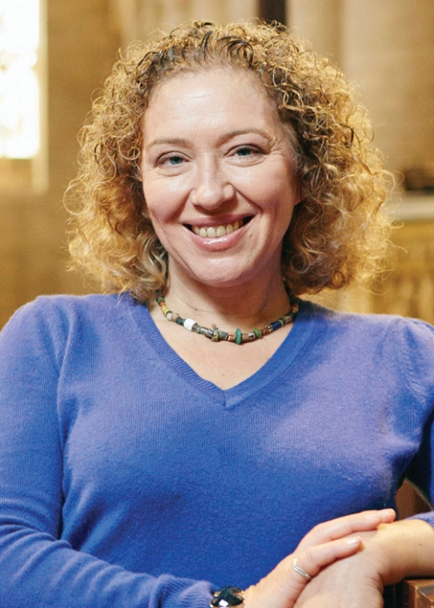












How did Queens shape the 16th century?
1139
Matilda tried to take the throne.
1553
Devise for the
Succession
1553 Mary Tudor is crowned
1558
Elizabeth I is crowned
1567
Mary QS
Forced to abdicate
1586
Babington
Plot
1587
Mary Queen of Scots executed
1588
Spanish Armada
 | Key Word | Definition
 | Abdicate | To give up the throne
 | Armada | Philip’s fleet which attempted an invasion of England in 1588.
 | Catholic | Christian religion. Belief in the Pope, use of Latin and highly decorated church.
 | Execution | Carry out a death sentence for a crime.
 | Heir | The person next in line to the throne.
 | Invasion | Attacking or occupying another country.
 | Monarch | A king or queen.
 | Plots | A plan made in secret.
 | Protestant | Christian religion. King is head of the Church, native language used, Church should be plain.
 | Rebellion | Rise up against the monarch.
 | Reform | To change or alter something.
 | Regent | To rule on behalf of someone else, often a child.
 | Succession | The throne passing from one to another.
 | Knowledge Milestones | Extra Knowledge | Expert Knowledge
 | Matilda was the only heir of Henry I. She was challenged by her cousin Stephen for the throne. | Eventually Matilda agreed to let Stephen rule, as long as her son succeeded him. | This period of time was known as the Anarchy It showed that Queens could be seen as weak.
 | Mary Tudor became the first crowned Queen of England. She was the oldest daughter of Henry VIII. | Her marriage to Philip of Spain was unpopular as English people did not want to be ruled by Spain. | She burnt Protestants as she was a Catholic. It is estimated that she burnt 280 Protestants during her reign.
 | Elizabeth took the throne in 1558. | She was a Protestant and introduced the Religious Settlement. | She remained unmarried - known as the Virgin Queen.
 | Elizabeth had to deal with threats from abroad, especially France and Spain. | Philip, the King of Spain, had been married to Elizabeth's sister Mary Tudor. | In 1588, he attempted an invasion with the Spanish Armada, but it failed.
 | Mary Queen of Scots was Elizabeth's cousin and had a claim on the English throne. | As a Catholic, she was involved in plots against Elizabeth like the Ridolfi Plot 1571. | After the Babington Plot of 1586, Mary Queen of Scots was executed by Elizabeth in 1587.
 | Lady Jane Grey was a cousin of Edward VI. | He tried to avoid passing the throne to Mary Tudor by issuing the "Devise for the Succession" which gave the throne to Jane. | Jane was only on the throne for 9 days before Mary Tudor rallied support and overthrew her.
 | There were several other female regents at this time. | Catherine de Medici ruled on behalf of her sons in France after 1560 | Margaret of Austria ruled the Netherlands for her nephew Charles V.
The time from the accession of Isabella of Castile to the throne in 1474 to France’s Massacre of St. Bartholomew almost a century later was an Age of Queens. The period saw an explosion of female rule scarcely equalled in even the twentieth century. These years saw the birth of the new reformed religion, as well as the dawn of the world we know today and for much of them, large swathes of Europe were under the firm hand of a reigning queen or a female regent. This was a sisterhood which recognised both their bonds as women and their ability to exercise power in a specifically female way.
Sarah Gristwood, Game of Queens
READ
WATCH
LISTEN
If you want to find out more check out the following links or scan the QR codes on your phone or tablet.
Historia Interviews: Sarah Gristwood – Historia Magazine
BBC Documentary Bloody Queens Elizabeth and Mary 2016 - Bing video
Inside the mind of Elizabeth I | History Extra podcast on Acast

Slide 2










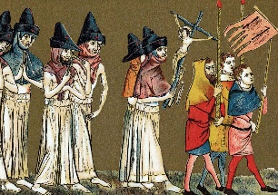
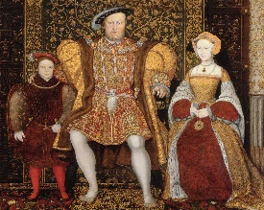
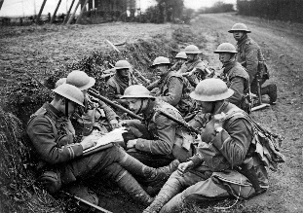


Writing good History: Key skills
Chronology
The order in which events happen. The big “story”.
Change/ Continuity
Whether things have changed or remained the same over time.
Similarity/Difference
What events or situations have in common, and how they are different.
Cause
The reasons that something happens- long term or trigger cause.
Consequence
Things that happen as a result of an event. Can be good or bad.
Significance
Whether an event is important or not. The impact it has had on people. How it has changed the world.
Sources
Information that comes from the time studied, or that was produced by someone who was there at the time.
Interpretations
The views of people who were not there at the time but have researched the event.
EXTENDED WRITING: What do I need to know?
USING SOURCES: What do I need to know?
 | Make sure you include more than once cause when asked to explain WHY something happened.
 | If asked if you AGREE you need to include arguments for why you do agree (SUPPORT the statement) and arguments for why you disagree (CHALLENGE the statement). This called having a BALANCED ARGUMENT.
 | Try to use the PEE structure- make a POINT that answers the question, add DETAILED EVIDENCE (examples) to support your point, and then EXPLAIN how these are linked.
 | Include ANALYSIS that measures the importance of each reason- are they long/short term? Which impacts more people? Are the reasons/points connected?
 | Say which reason is most important, or whether you agree or disagree with the statement. This can be done as a conclusion.
 | Inferences- to make an inference you need to state what you can learn, or work out from a source. Make sure you take note of the focus of the question!
 | Utility- when looking at how USEFUL a source is, you first must state what information the source gives you about the topic in the question. This is the CONTENT of he source. Does the source SUPPORT or CHALLENGE your own knowledge?
 | Utility- You next need to look at the PROVENANCE of the source. This means looking at who wrote the source, when it was written, what type of source it is and why it might have been produced. Do these things make the source RELIABLE?
 | If answering a “how useful” question you need to make a judgement- How useful is it? Extremely? Quite? Not very? Not at all? You can do this in a CONCLUSION
 | Whenever you use written sources you must QUOTE from the source, if using a picture source you must mention something you can SEE in the picture.
Suggested Vocabulary: What do I need to know?
To show importance | To agree/disagree | Linking points
The primary reason… | The evidence supports the view that… | This meant that…
The most significant cause… | This view is convincing because… | The impact of this was…
A crucial role was played by… | One reason to agree is… | In addition to this…
Of lesser importance was… | An alternative view is… | This acted as a catalyst for…
A key factor was… | A less supported view is… | This led to…
The fundamental cause… | A less convincing argument is… | An immediate consequence was…
A less significant reason… | It is clear that… | Long term this was significant because…
USING INTERPRETATIONS: What do I need to know?
 | When looking at the similarities or differences between interpretations make sure you mention the point of view given in BOTH interpretations.
 | If you are asked to suggest reasons WHY the interpretations have different views think about whether they FOCUS on different things, or whether one is POSITIVE and the other NEGATIVE, might the authors have done different RESEARCH?
 | To decide how far you AGREE with an interpretation, use your own knowledge- does this SUPPORT or CHALLENGE the view given in the interpretation?
 | You can also use sources to help you decide whether an interpretation is VALID- do the sources support or challenge the view in the interpretation? Are the sources RELIABLE?
 | Remember to always include QUOTES from the interpretations, and include a JUDGEMENT in the conclusion- do you agree?

