Slide 1
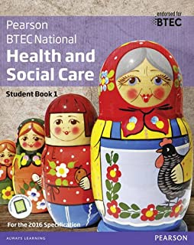
Level 3 BTEC Extended Certificate Health and Social Care
Passport to Sixth Form
Name: ________________________

Slide 2
Contents
What will I be studying? Page 3
Recommended Netflix Programmes Page 4
Other recommended watching Page 5
Recommended Reading Page 6
Learning Log Page 7
Key word Glossary Page 8-9
A-Z Challenge Page 10
Roles in Health and Social Care Page 11-13
Nightingale Hospitals Research Page 14
Extension Task – Pandemic Phases Page 15-16
Checklist for September Page 17

Slide 3
What will I be studying?
This course allows you to gain an insight into the many roles available within health and social care from nurses to social workers, paramedics and support workers. You will be studying four units which will help you to gain skills that will be valuable in your chosen profession or future study. You will learn about the human body and mind alongside the physical, intellectual, social and emotional changes across time. You will learn what it means to work in the Health and Social Care sector and what skills and behaviours you will need to develop. You will study the following units; although the final one is subject to change and you may not study them in this order.
During unit one, Human Lifespan Development, you will focus on:
The different influences on an individual’s development and how this relates to their care needs.
The biological, psychological and sociological theories associated with human lifespan development.
The physical effects of ageing and the psychological theories of ageing.
How you will be assessed: this is a paper based exam, that lasts for 1 hour 30 minutes, it is worth 90 marks. There are a variety of short and long answers. The questions are designed to test your knowledge on individual’s development, the factors that affect this and the theories that explain this.
During unit two, Working in Health and Social Care, you will focus on:
The roles and responsibilities of health and social care practitioners and the organisations they work for.
A wide range of roles, including doctors, nurses, physiotherapists, occupational therapists, social workers, youth workers, care workers and other professionals who work together to ensure that the individual needs of vulnerable people are met.
How you will be assessed: this is a paper based exam, that lasts for 1 hour 30 minutes and is worth 80 marks. There will be four sections which include short and long answers. The questions are intended to assess your understanding of the roles of different professionals and how health and care services meet the needs of individuals. Each section will relate to a different service user group, for example older people, people with learning disabilities, people with mental health problems or people with long-term illnesses.
During unit five, Meeting Individual Care and Support Needs, you will focus on:
The care and support that meets the needs of individuals in a health and social care environment. For this you need to understand the principles and practicalities that are the foundation of all the care disciplines.
A range of ethical issues that may arise when trying to meet patients and service users care and support needs and the challenges professionals may face in order to provide personalised care.
The different methods used by professionals working together in a multi-agency team to provide a package of care and support that meets individual needs.
How you will assessed: by a series of assignments set at College. You will provide practice assignments to help you prepare for the final assessment. You will need to check that your work first meets all the Pass criteria before moving on to Merit and then finally Distinction criteria.
The final unit will be a coursework-based unit where you will be set a series of assignments based on class work exploring a specific aspect of health, for example physiological or psychological care or additional needs. You will look at case studies as you will do for Unit 5 and use your knowledge to explain and apply a range of theories and concepts.

Slide 4
Babies
Marriage Story
Louis Theroux: Extreme love, Dementia
Five Feet Apart
Brain on Fire
Theory of Everything
What to expect when you’re expecting
Unbroken
Girl, interrupted
Call the Midwife
13 Reasons Why
Pandemic: How to prevent an outbreak
Recommended Watching for Health and Social Care

Slide 5
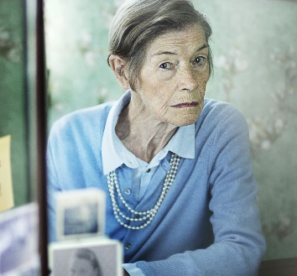
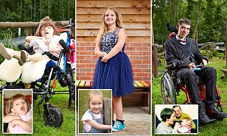
Beyond
Elizabeth is Missing
Rio & Kate: Becoming a Step family
Jesy Nelson: Odd one out
Bohemian Rhapsody
BBC iPlayer
DVD
Confessions of a Junior Doctor
Born to be different
Secret life of… Year Olds
Still Alice
4 On Demand
DVD
The Children Act
The Upside
Beautiful Boy
Miss you Already
Amazon Prime

Slide 6
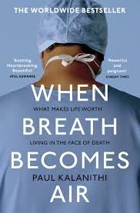
Beyond
Pig Heart Boy by Malorie Blackman
Wonder by R.J. Palacio
This is Going to Hurt by Adam Kay
When Breathe becomes Air by Paul Kalanithi
Further Reading
The Hate U Give by Angie Thomas
Me Before you by Jojo Moyes
The Fault in Our Stars by John Green
The Story of Baby P by Ray James
Savage Girls and Wild Boys by Michael Newton
The Language of Kindness by Christie Watson
I am Malala by Malala Yousafzai
The Boy Who Couldn’t Stop Washing by Dr Judith Rapaport
Recommended Reading for Health and Social Care
Yes some of these are also films, if you prefer!

Slide 7
Learning Log
Record here any additional reading/viewing you are undertaking in order to show what you have been completing in order to prepare you for the course. Use the reading list on the previous slides you have been given for guidance on what you could you watch/read. Complete the log and be prepared to discuss your reading and viewing.
Date | Title | Summary of content | My thoughts

Slide 8
Task: Research and define the following words which which will come up in your units. Then, draw a symbol to summarise the term and help you remember it.
Term | Definition
Adolescence | An important status change following the onset of puberty during which a young person develops from a child into a adult. The age range of adolescence is …..?
Advocate
Attachment
Care package
Clinical Commissioning Groups (CCGs)
Discrimination
Diversity
Empathy
Equality
PIES meaning in health and social care

Slide 9
Term | Definition
Fine Motor Skills
Growth
Holistic Approach
Milestone
Nature
Nurture
Risk Assessment
Safeguarding
Self-Concept
Self-Esteem

Slide 10
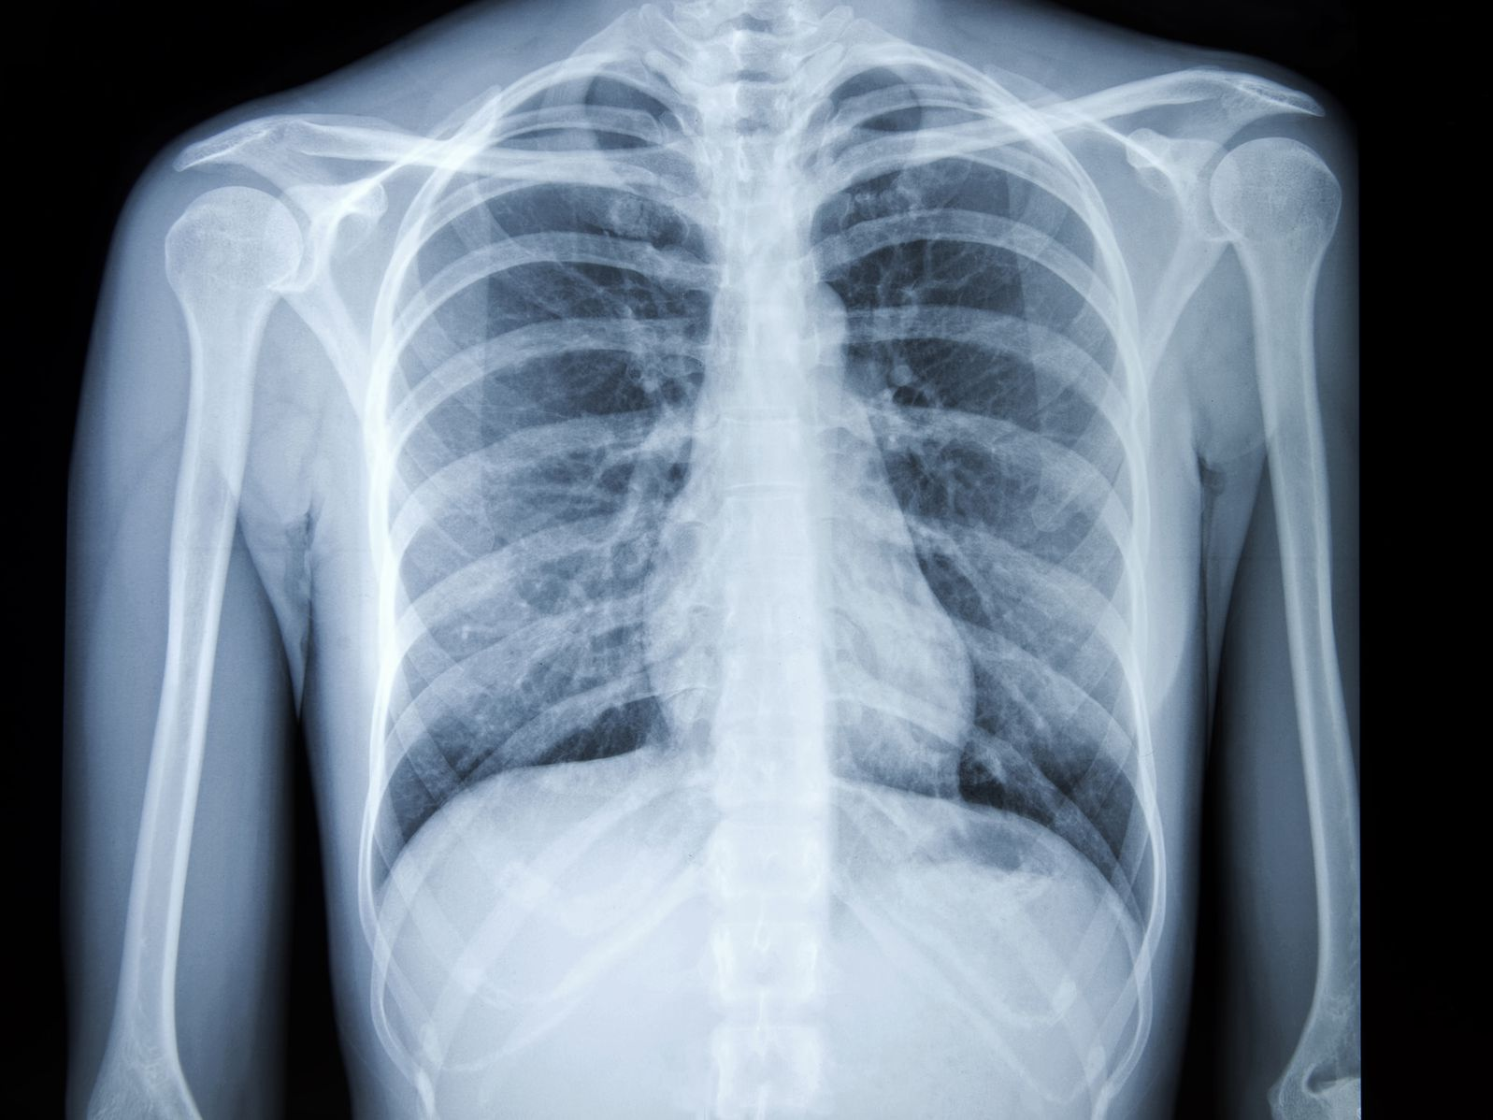
Research a list of Health and Social Care jobs/ medical terms for each letter of the alphabet
A
B
C
D
E
F
G
H
I
J
K
L
M
N
O
P
Q
R
S
T
U
V
W
X
Y
Z

Slide 11
Research task
Chose a professional from the following:
Midwife
Paramedic
Paediatric nurse
Nutritionist
Physiotherapist
You could choose your own idea from health and social care roles if you prefer – maybe the job role you are interested in?
Create a fact file for your chosen job role
You could include:
A day in the life of……
General roles and responsibilities
Routes into the role/ qualifications required
Skills & qualities
Average pay
Where they work
Who they work with
And anything else you think may be suitable

Slide 12
On ‘The front line’…….
What does it mean when people talk about being ‘on the front line’?
Government declares a ‘pandemic’…….
What does it mean when people talk about the situation as a pandemic?
Job Role | Definition | Roles and Responsibilities | How do they respond in a pandemic?
District Nurse
Auxiliary Nurse
Palliative Care
Phlebotomist
Domiciliary Carer
Adult Social Worker

Slide 13
True or False?
Colour code the statements in order to show if they are true or false.
True False
A palliative care nurse will get involved with everyone who gets coronavirus.
A district nurse will only work with the elderly.
Adult social workers support people with poor mental health.
Domiciliary carers provide care in the home.
Only phlebotomists are allowed to take blood.
Auxiliary nurses help support other nurses to do their roles.

Slide 14
NIGHTINGALE HOSPITALS RESEARCH TASK
Research the new Nightingale Hospitals.
Create a poster/PowerPoint/factsheet (information in the style of your choice) outlining the following:
How many there are
Where they are located
How many beds each one has
The difference between intensive care and a normal ward?
Challenge
How might the development of these hospitals impact the spread and control of the coronavirus?
How much have they been used?

Slide 15
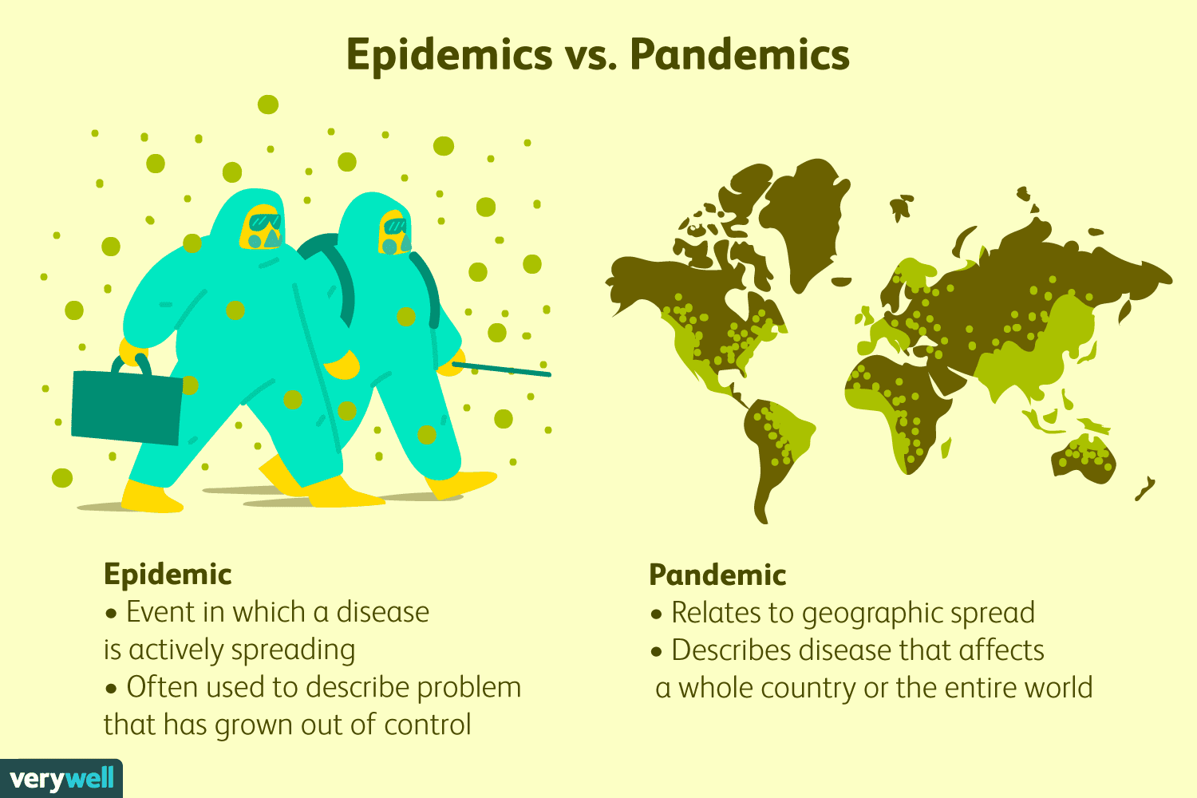
Extension Activity – optional Pandemic Phases
2018 marked the 100th anniversary of one of the largest public health crises in modern history, the 1918 influenza pandemic known colloquially as “Spanish flu.” The intensity and speed with which it struck were almost unimaginable – infecting one-third of the Earth’s population, which at the time was about 500 million people. By the time it subsided in 1920, tens of millions people are thought to have died. By 1952, it was decided that an influenza surveillance system was needed for the “collection, correlation, and distribution of information regarding occurrence, epidemiology and laboratory findings”. This is known as the Global Influenza Surveillance and Response System (GISRS). It was predicted that the next pandemic would most likely be caused by influenza.
This has lead WHO to conduct and watch outbreaks of strains of flu and colds across the world and create detailed reports on the readiness of countries and also to map out the stages of a pandemic and main actions to be taken in order to minimise the impact of this type of event.
Task 5: Below is a link to the WHO pandemic phase descriptions; use these alongside research on the response to the COVID-19 Pandemic in order to complete the table on the next slide.
https://www.who.int/influenza/resources/documents/pandemic_phase_descriptions_and_actions.pdf

Slide 16
Phase | WHO Suggested Actions | UK Actions | Effectiveness of response | Recommendations for future pandemic planning
1
2
3
4
5
6
Post Peak

Slide 17
Passport to Sixth Form Check list
Use this list to make sure you have everything you need to hand in when you start your Level 3 BTEC in Health and Social Care.
Complete at least 3 sections of the learning log, page 7
Completed glossary of key terms, page 8-9
Filled in A-Z of Health and Social Care, page 10
One in depth fact file on a role within the Health and Social Care sector and other activities, page 11-13
Completed Nightingales Hospital research, page 14.
Optional, Extension task – Pandemic phases 15-16
We are very much looking forward to meeting you when you begin your Post 16 Health and Social Care learning journey
Mrs Rawles and the team
If you have any questions relating to this work or the course, you can contact me at anna.rawles@exmouthcollege.devon.sch.uk

