Slide 1
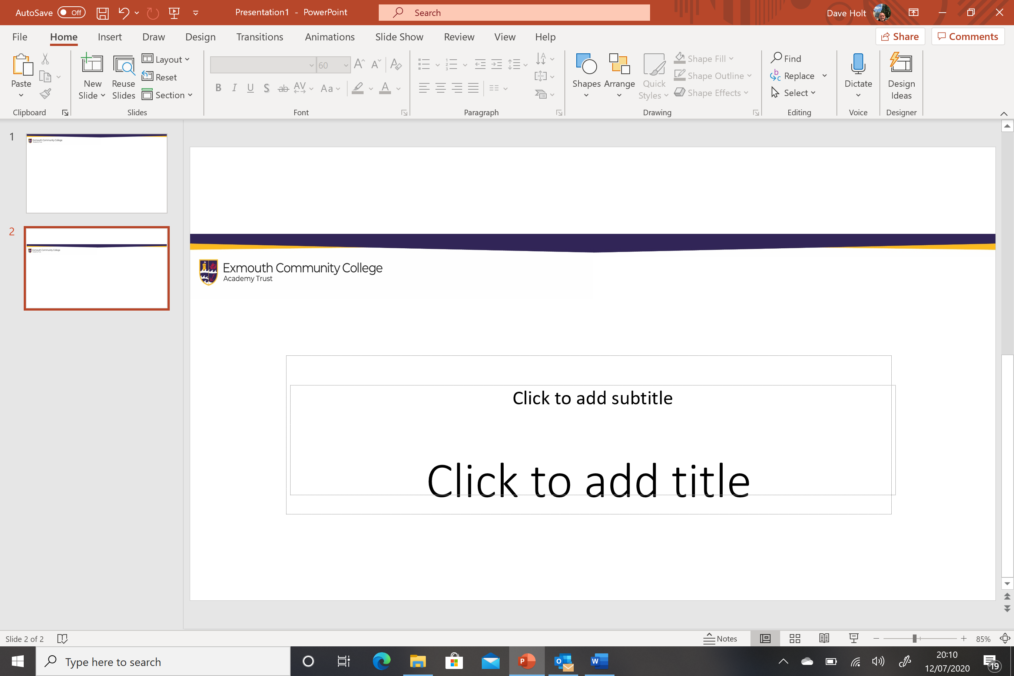
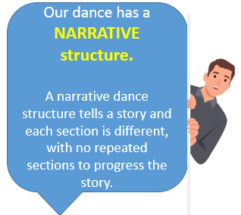
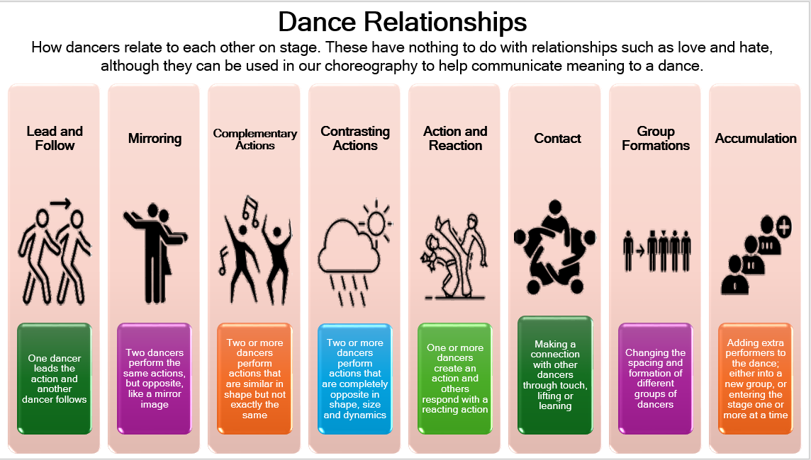
The Windrush Generation
BBC Bitesize Windrush Generation Video Link
In 1948 Britain was just starting to recover from the Second World War. Towns and cities had been bombed. Thousands of homes and buildings were destroyed and they all needed to be rebuilt.
In the Caribbean, thousands of men and women had served in the British armed forces. After the war, some of them answered an advert to come to Britain where there were lots of different jobs available.
Other people just wanted to see England, which they’d heard so much about. They all got on a ship, Empire Windrush, which left the Caribbean to travel thousands of miles across the Atlantic Ocean.
This was the first time so many Caribbean people had come to live in Britain. Many more arrived in the following 23 years.
It was on the 22nd June 1948 that the Empire Windrush arrived at Tilbury Docks in Essex. But when its passengers got off, they found that Britain was not as friendly to them as they had hoped. It was cold and grey and the Caribbean people soon experienced racism and discrimination.
They found it hard to get proper homes to live in and to make friends with British people. Later many of their children were bullied at school because of the colour of their skin.
There were racial attacks and years later, race riots broke out in cities across Britain. Settling into a new country was difficult and black people had to stick together and support one another.
The Windrush Generation worked in important jobs in transport and healthcare. They brought music, food and much more to British culture.
In 1966 Claudia Jones started the Notting Hill Carnival. This is a celebration in London of Caribbean music, dance and costumes.
Year 8 Dance: Knowledge Organiser: Term 1
Revise the name and definition of all Dance Relationships for the Knowledge Quiz.
Revise the story of Windrush
Revise narrative dance structure

Slide 2
Year 8 Dance Knowledge Organiser: Term 2
Mental Skills
In rehearsals:
Systematic repetition
Mental rehearsal
Rehearsal Discipline
Planning of rehearsals
Responding to feedback
Having the capacity and willingness to improve
Physical Skills
Posture
Alignment
Balance
Coordination
Control
Flexibility
Mobility
Strength
Stamina
Expressive Skills
Projection
Focus
Spatial awareness
Facial expressions
Phrasing
Musicality
Sensitivity to other dancers
To communicate the intention of the dance
Physical Skills
Definition:
The skills your body needs to perform with control and make the dance look easy!
Characteristics:
Strength, stamina, flexibility, control, posture, balance, co-ordination
Examples:
“I needed to develop my physical skill of stamina as the dance was 30 minutes long and I started to loose strength and control after 20 minutes”.
Non-examples:
Expressive skills, specific styles
Expressive Skills
Definition:
The ability to express the meaning of the dance and communicate with the audience
Characteristics:
Facial expressions, musicality, focus, projection, communicating the meaning of the dance
Examples:
“In order to show the audience the emotion of the dance, I needed to express sadness in my facial expressions”.
Non-examples:
Strength, stamina, timing

